Slide 1
Preventing Hypothermia in Neonates
The Warm Chain

Slide 2
What is warm chain?
Warm chain is a series of interlinked steps to prevent hypothermia in neonates

Slide 3
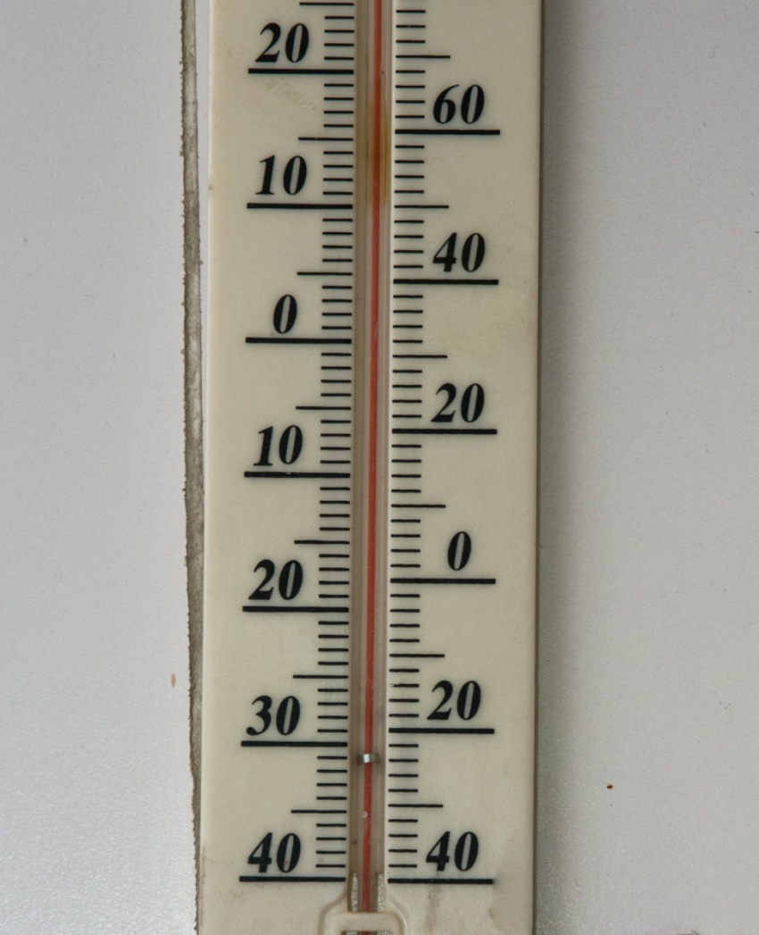
1. Keep the room warm
Make sure the delivery room is kept at 26-28°C

Slide 4
2. Skin-to-skin contact (STS)
For stable babies, start skin-to-skin contact on the mother’s abdomen immediately after birth
Allow breast crawl for up to an hour
Vitamin K & weighing: after STS

Slide 5
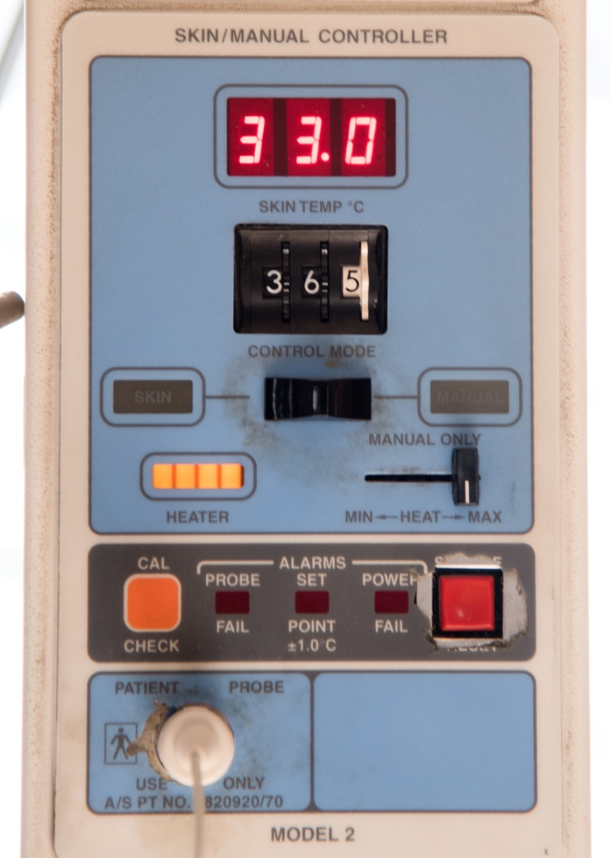
3. Warm resuscitation
Switch on warmer 20-30 minutes before delivery
Warm at least 2 sheets

Slide 6
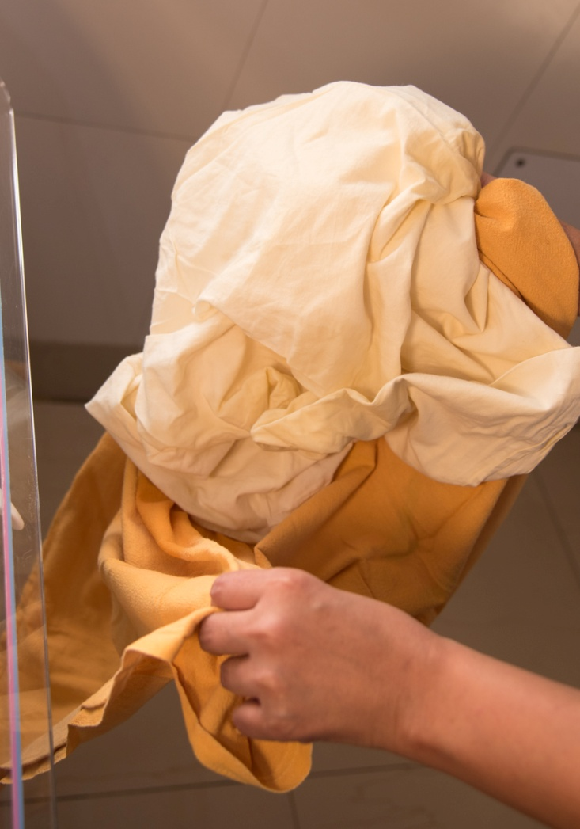
4. Immediate drying
Dry skin with warm cloth
Discard wet cloth after wiping
Wrap in dry towel
Cover head or put cap on
Plastic bag/wrap if < 32 weeks

Slide 7
5. Exclusive breastfeeding
Continue skin-to-skin care
Breastfeed within 1 hour
Feed as soon as possible after C-section
Discourage prelacteal feeds

Slide 8
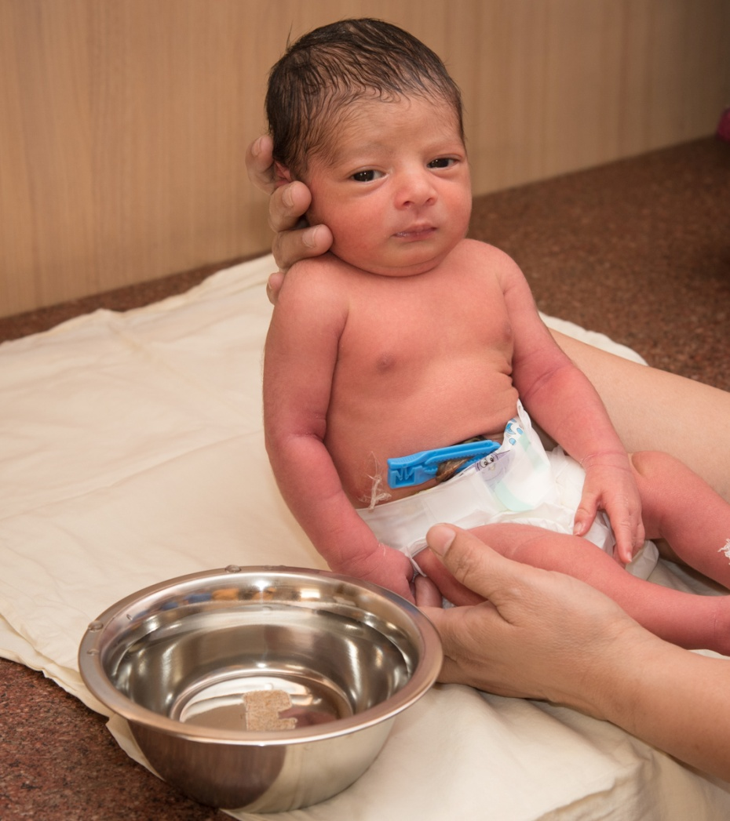
6. Postpone bathing
Postpone bathing for 24 hours

Slide 9
7. Appropriate clothing
Cover head. Use cap, socks, and mittens
Extra clothing in winter
Change wet nappies promptly

Slide 10
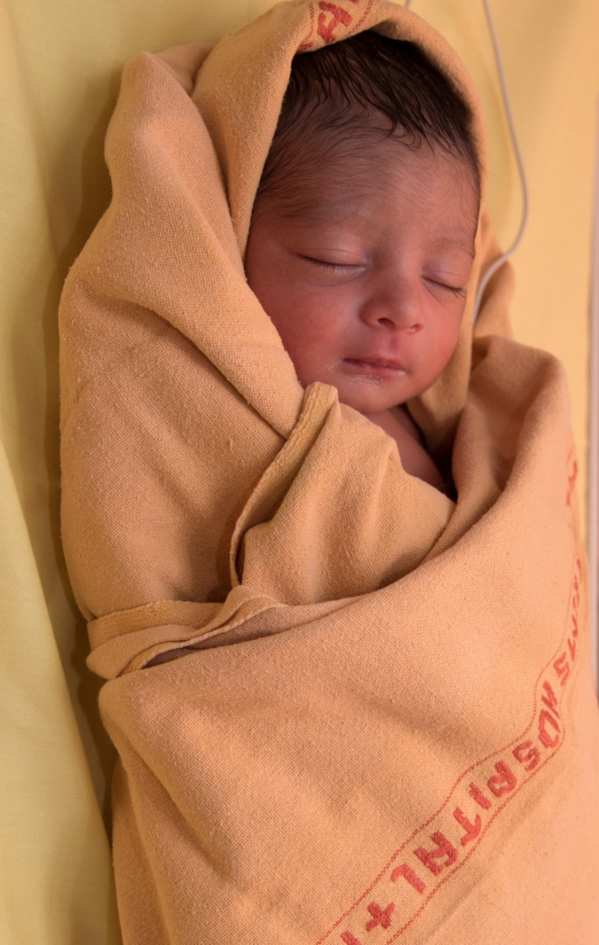
8. Keep with mother
Rooming in
Bedding in
If not in Kangaroo Mother Care, wrap and place next to mother

Slide 11
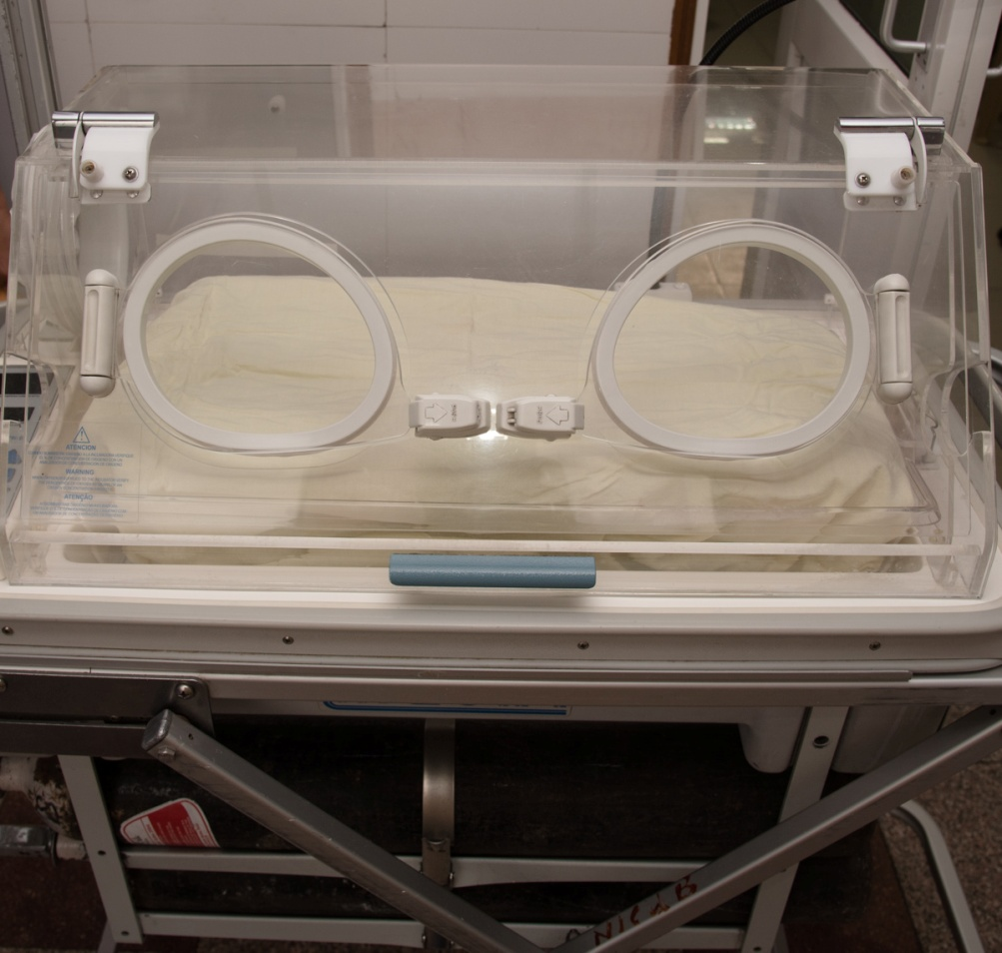
9. Warm transportation
Transport incubator
Skin-to-skin
Wrapping
In-utero transfer for high-risk pregnancies

Slide 12
10. Training & awareness
Educate all members of team
Train all members in resuscitation, skin-to-skin, breastfeeding, use of equipment like radiant warmers and incubators
Ongoing program to train new staff and retrain others

Slide 13
Summary
Increased awareness and a series of simple measures are all that is needed to prevent hypothermia in most neonates.

Slide 14
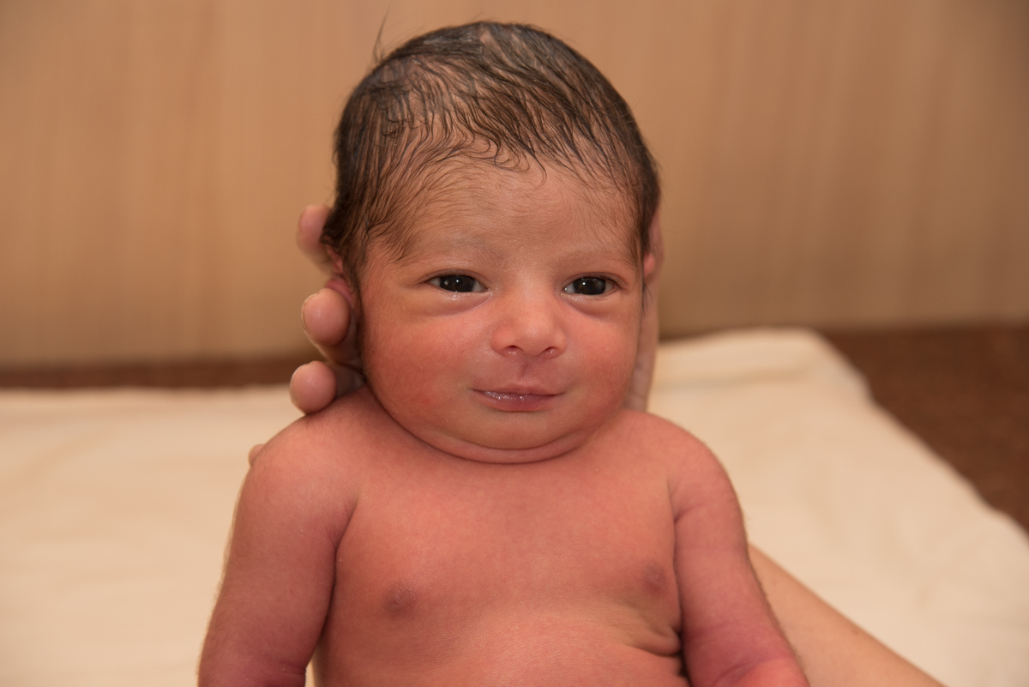
Thank you!

